Slide 1
Agricultural Data Insights
Power BI Dashboard Summary

Slide 2
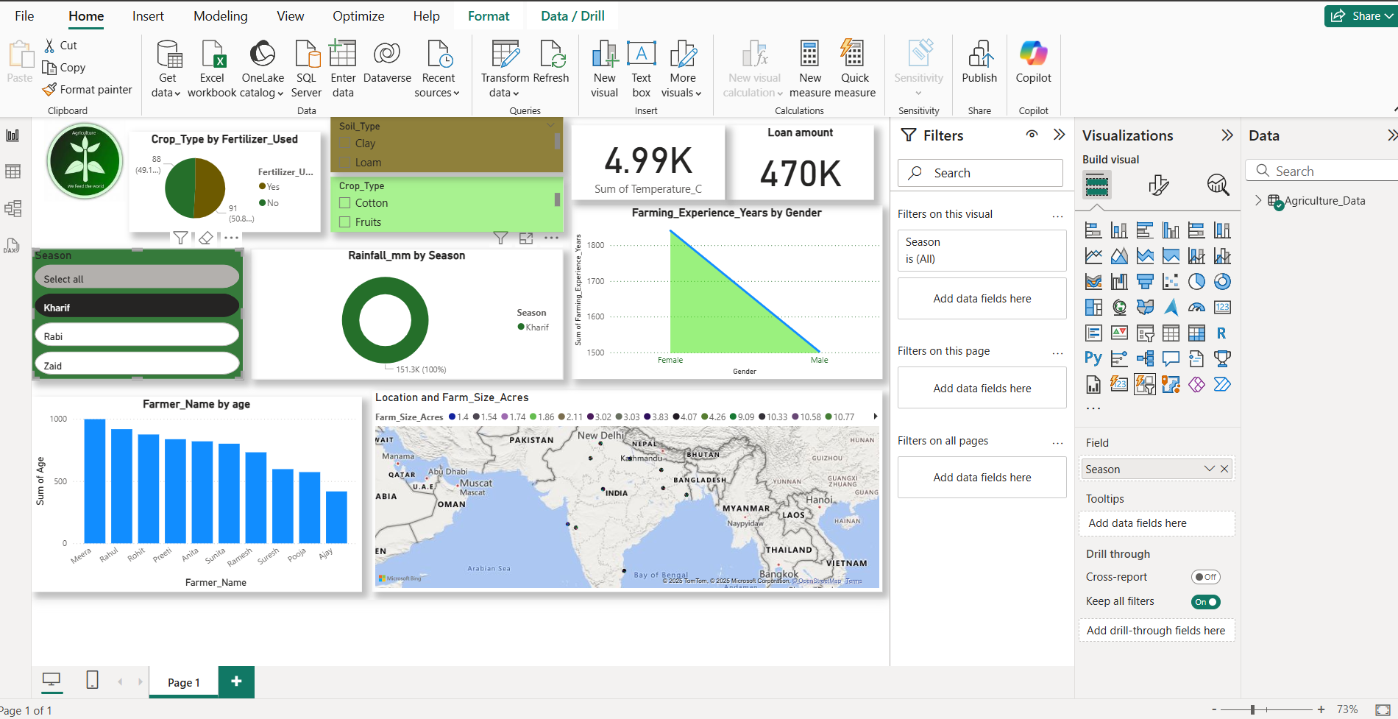

Slide 3
Crop Type by Fertilizer Used
- 88 crop records used fertilizer (17.63%).
- 91 crop records did not use fertilizer (18.22%).
- Majority of records have unknown or filtered-out values.

Slide 4
Rainfall by Season
- Kharif season: 15.13K units (86.63%).
- Zaid and Rabi seasons contribute significantly less.
- Indicates seasonal dependence of rainfall.

Slide 5
Farming Experience by Gender
- Females have nearly 1800 years of total experience.
- Males have around 1500 years.
- Women show higher cumulative experience.

Slide 6
Farmer Age Distribution
- Farmers like Nitesh, Pawan, Praveen are among the older ones.
- A descending trend in age is visible across listed names.

Slide 7
Temperature and Record Count
- Total temperature sum: 4.99K.
- Total records: 470K.
- Indicates a large dataset with significant temperature tracking.

Slide 8
Location and Farm Size
- Farms spread across South Asia and the Middle East.
- India is the primary location.
- Most farm sizes range between 1.4 to 10.77 acres.

